Slide 1
Module 6: Synchronization

Slide 2
Module 6: Process Synchronization
Background
The Critical-Section Problem
Peterson’s Solution
Synchronization Hardware
Semaphores
Classic Problems of Synchronization
Monitors
Synchronization Examples
Atomic Transactions

Slide 3
Objectives
To introduce the critical-section problem, whose solutions can be used to ensure the consistency of shared data
To present both software and hardware solutions of the critical-section problem
To introduce the concept of an atomic transaction and describe mechanisms to ensure atomicity

Slide 4
Background
Concurrent access to shared data may result in data inconsistency
Maintaining data consistency requires mechanisms to ensure the orderly execution of cooperating processes
Suppose that we wanted to provide a solution to the consumer-producer problem that fills all the buffers. We can do so by having an integer count that keeps track of the number of full buffers. Initially, count is set to 0. It is incremented by the producer after it produces a new buffer and is decremented by the consumer after it consumes a buffer.

Slide 5
Consumer
Producer
while (true) {
while (count == 0)
; // do nothing
nextConsumed = buffer[out];
out = (out + 1) % BUFFER_SIZE;
count--;
/* consume the item in nextConsumed */
}
while (true) {
/* produce an item and put in nextProduced */
while (count == BUFFER_SIZE)
; // do nothing
buffer [in] = nextProduced;
in = (in + 1) % BUFFER_SIZE;
count++;
}

Slide 6
Race Condition
count++ could be implemented as
register1 = count
register1 = register1 + 1
count = register1
count-- could be implemented as
register2 = count
register2 = register2 - 1
count = register2
Consider this execution interleaving with “count = 5” initially:
  S0: producer execute register1 = count {register1 = 5}
  S1: producer execute register1 = register1 + 1 {register1 = 6}
  S2: consumer execute register2 = count {register2 = 5}
  S3: consumer execute register2 = register2 - 1 {register2 = 4}
  S4: producer execute count = register1 {count = 6 }
  S5: consumer execute count = register2 {count = 4}

Slide 7
Critical-Section Problem
Race Condition - When there is concurrent access to shared data and the final outcome depends upon order of execution.
Critical Section - Section of code where shared data is accessed.
Entry Section - Code that requests permission to enter its critical section.
Exit Section - Code that is run after exiting the critical section

Slide 8
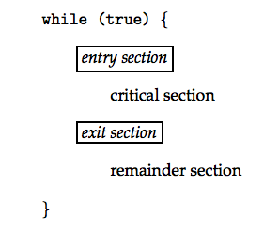
Structure of a Typical Process

Slide 9
Solution to Critical-Section Problem
Mutual Exclusion - If process P_{i} is executing in its critical section, then no other processes can be executing in their critical sections
Progress - If no process is executing in its critical section and there exist some processes that wish to enter their critical section, then the selection of the processes that will enter the critical section next cannot be postponed indefinitely
3. Bounded Waiting - A bound must exist on the number of times that other processes are allowed to enter their critical sections after a process has made a request to enter its critical section and before that request is granted
  Assume that each process executes at a nonzero speed
  No assumption concerning relative speed of the N processes

Slide 10
Peterson’s Solution
Two process solution
Assume that the LOAD and STORE instructions are atomic; that is, cannot be interrupted.
The two processes share two variables:
  int turn;
  Boolean flag[2]
The variable turn indicates whose turn it is to enter the critical section.
The flag array is used to indicate if a process is ready to enter the critical section. flag[i] = true implies that process P_{i} is ready!

Slide 11
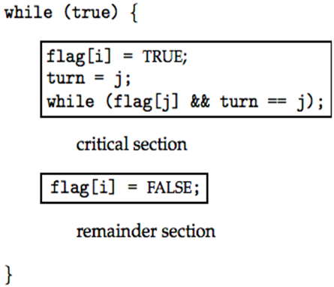
Algorithm for Process
P_{i}
Algorithm for Process
P_{j}
while (true) {
flag[ j] = TRUE;
turn = i;
while ( flag[i] && turn == i);
CRITICAL SECTION
flag[ j] = FALSE;
REMAINDER SECTION
}

Slide 12
Synchronization Hardware
Many systems provide hardware support for critical section code
Uniprocessors – could disable interrupts
  Currently running code would execute without preemption
  Generally too inefficient on multiprocessor systems
    Operating systems using this not broadly scalable
Modern machines provide special atomic hardware instructions
    Atomic = non-interruptable
  Either test memory word and set value
  Or swap contents of two memory words

Slide 13
Solution to Critical-section Problem Using Locks
do {
acquire lock
critical section
release lock
remainder section
} while (TRUE);

Slide 14
TestAndndSet Instruction
Definition:
boolean TestAndSet (boolean *target)
{
boolean rv = *target;
*target = TRUE;
return rv:
}

Slide 15
Solution using TestAndSet
Shared boolean variable lock., initialized to false.
Solution:
do {
while ( TestAndSet (&lock ))
; // do nothing
// critical section
lock = FALSE;
// remainder section
} while (TRUE);

Slide 16
Swap Instruction
Definition:
void Swap (boolean *a, boolean *b)
{
boolean temp = *a;
*a = *b;
*b = temp:
}

Slide 17
Solution using Swap
Shared Boolean variable lock initialized to FALSE; Each process has a local Boolean variable key
Solution:
do {
key = TRUE;
while ( key == TRUE)
Swap (&lock, &key );
// critical section
lock = FALSE;
// remainder section
} while (TRUE);

Slide 18
Bounded-waiting Mutual Exclusion with TestandSet()
do {
// critical section
// remainder section
} while (TRUE);
waiting[i] = TRUE;
key = TRUE;
while (waiting[i] && key)
key = TestAndSet(&lock);
waiting[i] = FALSE;
j = (i + 1) % n;
while ((j != i) && !waiting[j])
j = (j + 1) % n;
if (j == i)
lock = FALSE;
else
waiting[j] = FALSE;

Slide 19
Semaphore
Synchronization tool that does not require busy waiting
Semaphore S – integer variable
Two standard operations modify S: wait() or acquire() and signal() or release()
  Originally called P() and V()
Less complicated
Can only be accessed via two indivisible (atomic) operations
  wait (S) {
  while S <= 0
  ; // no-op
  S--;
  }
  signal (S) {
  S++;
  }

Slide 20
Semaphore as General Synchronization Tool
Counting semaphore – integer value can range over an unrestricted domain
Binary semaphore – integer value can range only between 0
and 1; can be simpler to implement
  Also known as mutex locks
Can implement a counting semaphore S as a binary semaphore
Provides mutual exclusion
  Semaphore mutex; // initialized to 1
  do {
  wait (mutex);
  // Critical Section
  signal (mutex);
  // remainder section
  } while (TRUE);

Slide 21
Semaphore Implementation
Must guarantee that no two processes can execute wait () and signal () on the same semaphore at the same time
Thus, implementation becomes the critical section problem where the wait and signal code are placed in the crtical section.
  Could now have busy waiting in critical section implementation
    But implementation code is short
    Little busy waiting if critical section rarely occupied
Note that applications may spend lots of time in critical sections and therefore this is not a good solution.

Slide 22
Semaphore Implementation with no Busy waiting
With each semaphore there is an associated waiting queue. Each entry in a waiting queue has two data items:
  value (of type integer)
  pointer to next record in the list
Two operations:
  block – place the process invoking the operation on the appropriate waiting queue.
  wakeup – remove one of processes in the waiting queue and place it in the ready queue.

Slide 23
Semaphore Implementation with no Busy waiting (Cont.)
Implementation of wait:
wait(semaphore *S) {
S->value--;
if (S->value < 0) {
add this process to S->list;
block();
}
}
Implementation of signal:
signal(semaphore *S) {
S->value++;
if (S->value <= 0) {
remove a process P from S->list;
wakeup(P);
}
}

Slide 24
Deadlock and Starvation
Deadlock – two or more processes are waiting indefinitely for an event that can be caused by only one of the waiting processes
Let S and Q be two semaphores initialized to 1
P₀ P₁
wait (S); wait (Q);
wait (Q); wait (S);
. .
. .
. .
signal (S); signal (Q);
signal (Q); signal (S);
Starvation – indefinite blocking. A process may never be removed from the semaphore queue in which it is suspended
Priority Inversion - Scheduling problem when lower-priority process holds a lock needed by higher-priority process

Slide 25
Classical Problems of Synchronization
Bounded-Buffer Problem
Readers and Writers Problem
Dining-Philosophers Problem

Slide 26
Bounded-Buffer Problem
N buffers, each can hold one item
Semaphore mutex initialized to the value 1
Semaphore full initialized to the value 0
Semaphore empty initialized to the value N.

Slide 27
Bounded Buffer Problem (Cont.)
The structure of the producer process
do {
// produce an item in nextp
wait (empty);
wait (mutex);
// add the item to the buffer
signal (mutex);
signal (full);
} while (TRUE);
The structure of the consumer process
do {
wait (full);
wait (mutex);
// remove an item from // buffer to nextc
signal (mutex);
signal (empty);
// consume the item in nextc
} while (TRUE);

Slide 28
Readers-Writers Problem
A data set is shared among a number of concurrent processes
  Readers – only read the data set; they do not perform any updates
  Writers – can both read and write
Problem – allow multiple readers to read at the same time. Only one single writer can access the shared data at the same time
Shared Data
  Data set
  Semaphore mutex initialized to 1
  Semaphore wrt initialized to 1
  Integer readcount initialized to 0

Slide 29
Readers-Writers Problem (Cont.)
The structure of a writer process
do {
wait (wrt) ;
// writing is performed
signal (wrt) ;
} while (TRUE);
The structure of a reader process
do {
wait (mutex) ;
readcount ++ ;
if (readcount == 1)
wait (wrt) ;
signal (mutex)
// reading is performed
wait (mutex) ;
readcount - - ;
if (readcount == 0)
signal (wrt) ;
signal (mutex) ;
} while (TRUE);

Slide 30
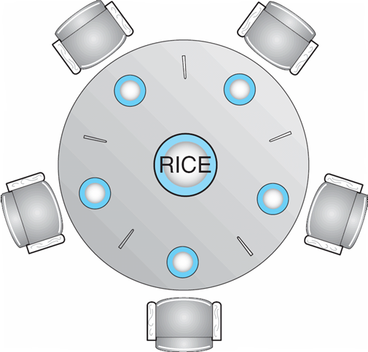
Dining-Philosophers Problem
Shared data
  Bowl of rice (data set)
  Semaphore chopstick [5] initialized to 1

Slide 31
Dining-Philosophers Problem (Cont.)
The structure of Philosopher i:
    do {
    wait ( chopstick[i] );
    wait ( chopStick[ (i + 1) % 5] );
    // eat
    signal ( chopstick[i] );
    signal (chopstick[ (i + 1) % 5] );
    // think
    } while (TRUE);

Slide 32
Problems with Semaphores
Incorrect use of semaphore operations:
  signal (mutex) …. wait (mutex)
  wait (mutex) … wait (mutex)
  Omitting of wait (mutex) or signal (mutex) (or both)

Slide 33
Monitors
A high-level abstraction that provides a convenient and effective mechanism for process synchronization
Only one process may be active within the monitor at a time
    monitor monitor-name
    {
    // shared variable declarations
    procedure P1 (…) { …. }
    …
    procedure Pn (…) {……}
    Initialization code ( ….) { … }
    …
    }
    }

Slide 34
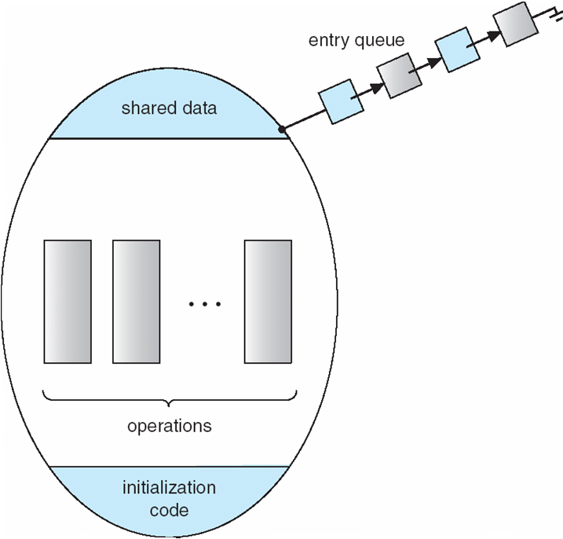
Schematic view of a Monitor

Slide 35
Condition Variables
condition x, y;
Two operations on a condition variable:
  x.wait () – a process that invokes the operation is
  suspended.
  x.signal () – resumes one of processes (if any) that
  invoked x.wait ()

Slide 36

Monitor with Condition Variables

Slide 37
Solution to Dining Philosophers
monitor DP
{
enum { THINKING; HUNGRY, EATING) state [5] ;
condition self [5];
//-------------------------------------------------
void pickup (int i) {
state[i] = HUNGRY;
test(i);
if (state[i] != EATING) self [i].wait;
}
//-------------------------------------------------
void putdown (int i) {
state[i] = THINKING;
// test left and right neighbors
test((i + 4) % 5);
test((i + 1) % 5);
}
//-------------------------------------------------
void test (int i) {
if ( (state[(i + 4) % 5] != EATING) &&
(state[i] == HUNGRY) &&
(state[(i + 1) % 5] != EATING) ) {
state[i] = EATING ;
self[i].signal () ;
}
}
//-------------------------------------------------
initialization_code() {
for (int i = 0; i < 5; i++)
state[i] = THINKING;
}
} // End of Monitor Definition

Slide 38
Solution to Dining Philosophers (cont)
Each philosopher I invokes the operations pickup()
and putdown() in the following sequence:
DP.pickup (i);
EAT
DP.putdown (i);

Slide 39
End of Chapter 16

